Slide 1


Team 71: Virtual Computer Mouse using mmWave Radar (TI) Final Presentation
Oscar Chavez Araiza
Greyson Heath
Daniel Lu
Zane Meikle
Sponsor: Nick Farrell, Texas Instruments
TA: Vishwam Raval

Slide 2
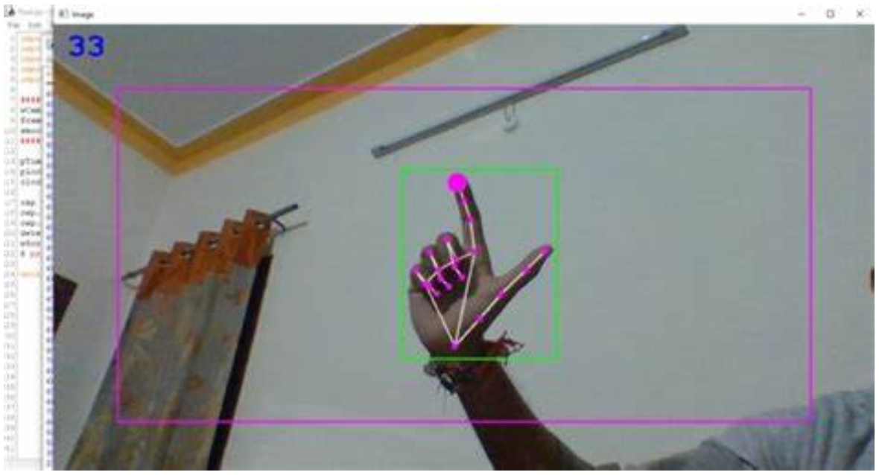
Project Summary:
Problem statement:
Virtual mice today are traditionally done using computer vision and a camera (as seen on the right).
But these systems are processing and power intensive.
High-level summary:
Create a virtual mouse using a Texas Instruments (TI) mmWave Radar and a ML model to make a less power and processing intensive virtual mouse.
Notes:
Zane

Slide 3
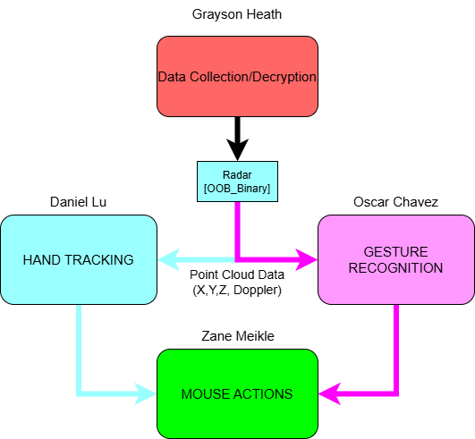
Integrated System Diagram
Notes:
Everyone

Slide 4
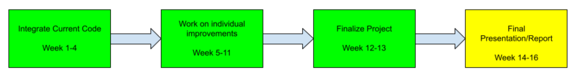
Project Timeline This Semester (404)
Notes:
Zane

Slide 5
Major Project Changes for 404
Following additions were integrated to improve the virtual mouse:
Interactive GUI - Allows user to change settings (Greyson)
Radar enclosure case - Protects device and looks presentable (Greyson)
Improving AI for gestures - Used different binary and added new gesture for additional functionality(Oscar)
Mouse frame smoothing - Connect point A to point B with arbitrary frames to smooth motion (Zane)
Improving accuracy - improve the accuracy and control of the mouse (Daniel)
Notes:
Oscar

Slide 6
Team Wide Updates
We reduced the total number of radars used to 1
The Out of Box Demo binary was flashed into the radar
We made our new functions work in parallel to make the code more efficient and run better
Notes:
Zane

Slide 7
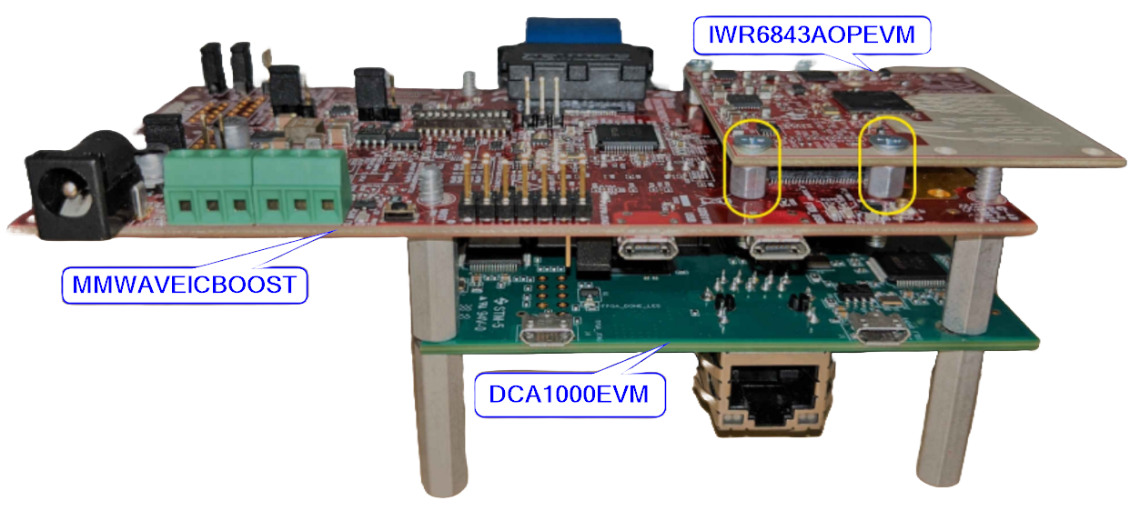
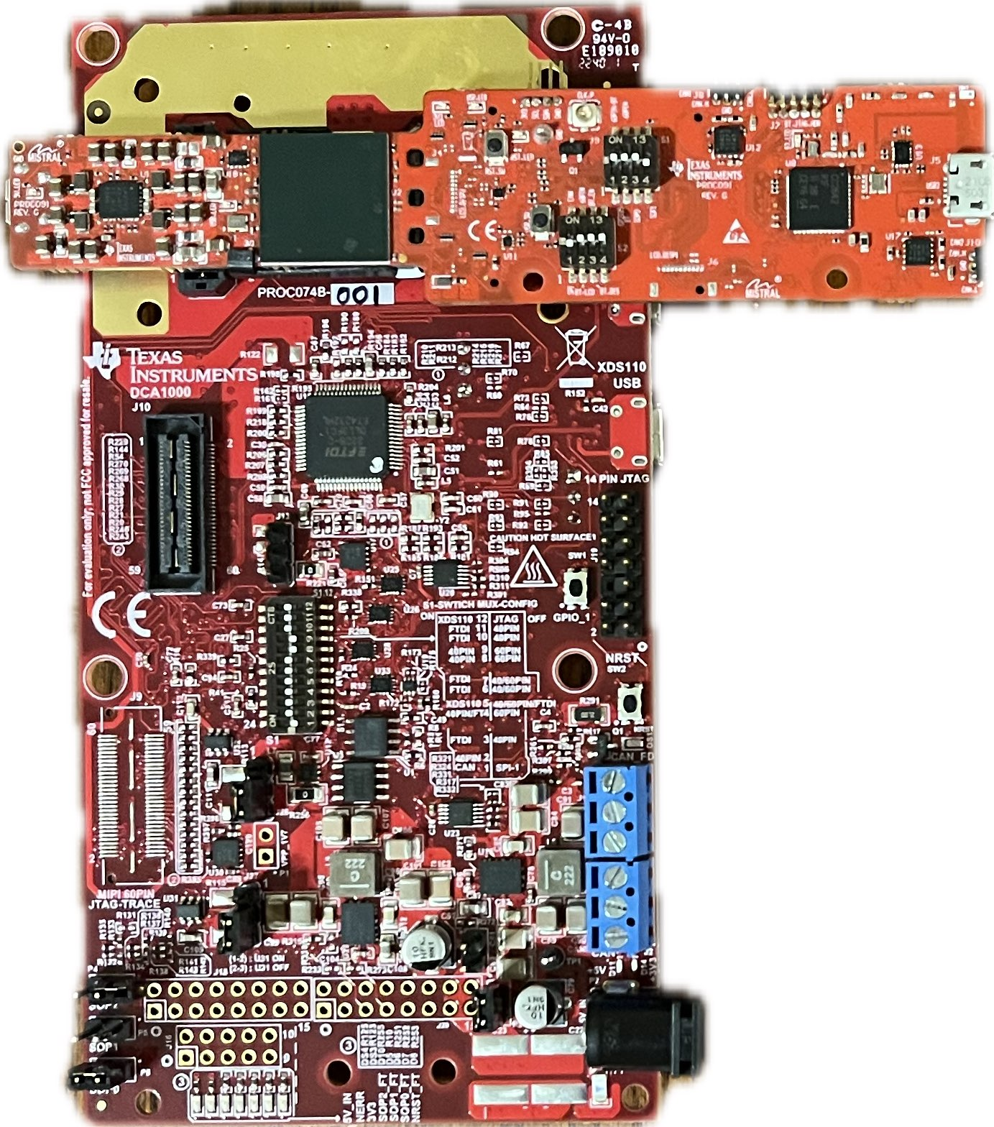
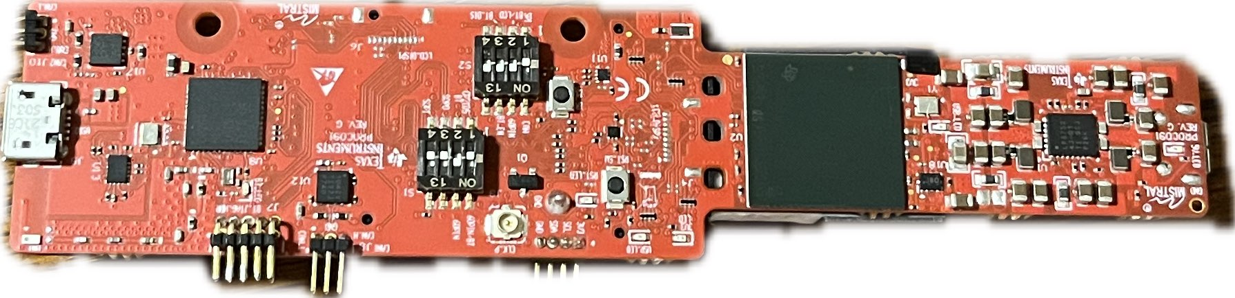

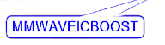
Downsizing
Notes:
Greyson then Oscar

Slide 8

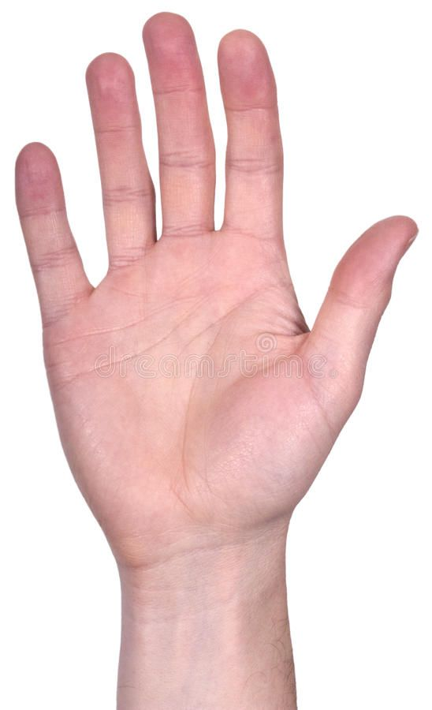
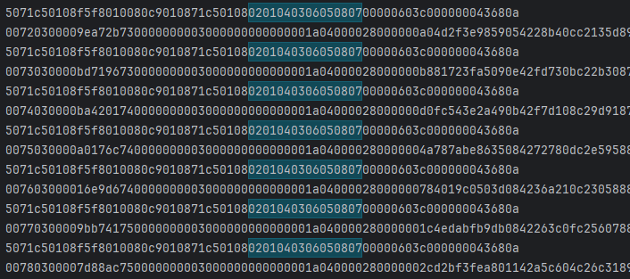
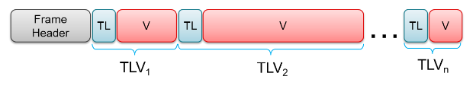
Radar Operation
Radar Config / Collect Data
Greyson Heath
Emits pulsed chirp signals (echolocation)
Flashed with TI provided binary
Optimize radar to detect hand
Outputs (X, Y, Z, doppler)
Pass forward data for further processing
Notes:
Emits pulsed chirp signals, awaits echo, similar to bats using echo location
Flashed with TI binary, a program that tells the radar to run specific calculations and output results
Binary enabled me to effectively tune radar to best detect a hand
resulting raw data seen in corner
Radar runs at 30 FPS, and per frame a variable number of points are detected which are represented by the variable TLV, type length value, data structure
Highlighted blue text denotes the beginning of each frame header and is referred to as TI’s “magic word”
X. Y. Z. and doppler information is extracted from each point and passed forward for further data processing.

Slide 9
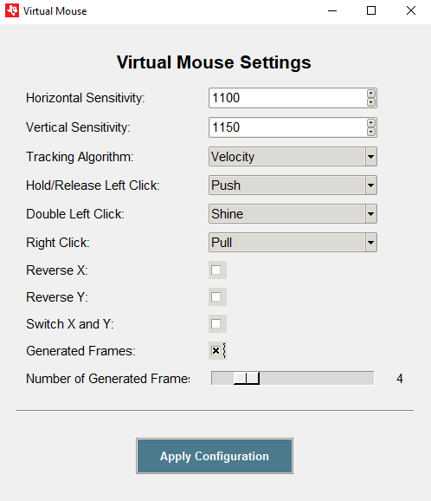
Radar Case and GUI
Radar Config / Collect Data
Greyson Heath
Modeled and printed enclosure for radar using Autodesk Inventor Pro
Printed with Bambu P1S
Python GUI implemented using Tkinter library
Notes:
This semester I have primarily worked on creating a case and mount for the radar to attach it to the computer, as well as creating a graphical user interface to change a variety of settings, such as the sensitivity, tracking algorithm used, and gesture actions. On the right is a screenshot of the GUI that displays after starting the virtual mouse.

Slide 10
Project Accomplishments
Radar Config / Collect Data
Greyson Heath
Successfully configured TI provided radar to transmit meaningful data, decoded and passed forward (X, Y, Z, Doppler)
Project scope and major connectivity issues faced in the beginning of project
Modeled and printed enclosure and mount for radar
New to using Inventor/CAD programs alike
Implemented Python GUI using Tkinter library

Slide 11
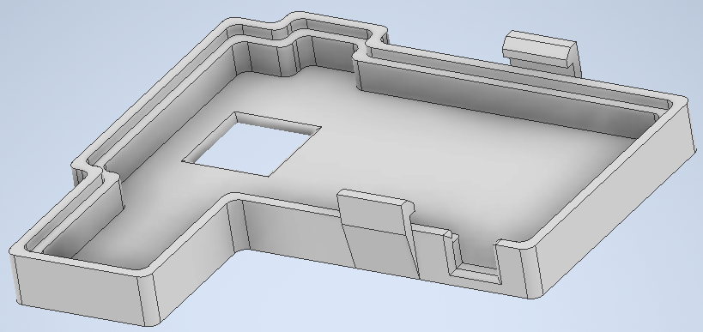
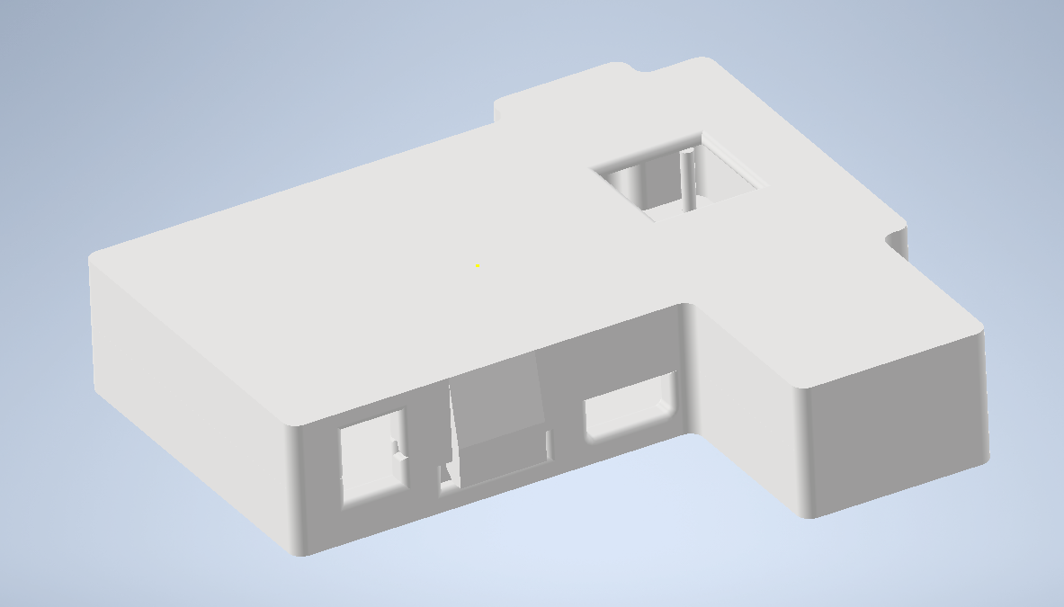
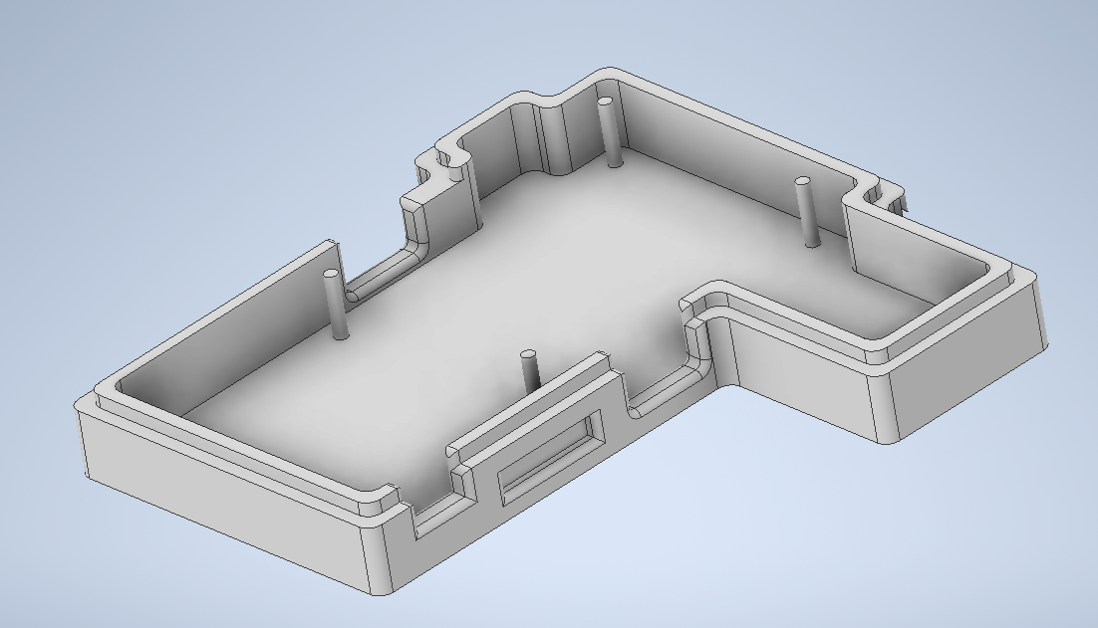
First Model of Case
Notes:
Here is the first case prototype when we planned on using an additional software development board with the radar device. Due to us downsizing to solely the radar device, I never printed this model.

Slide 12
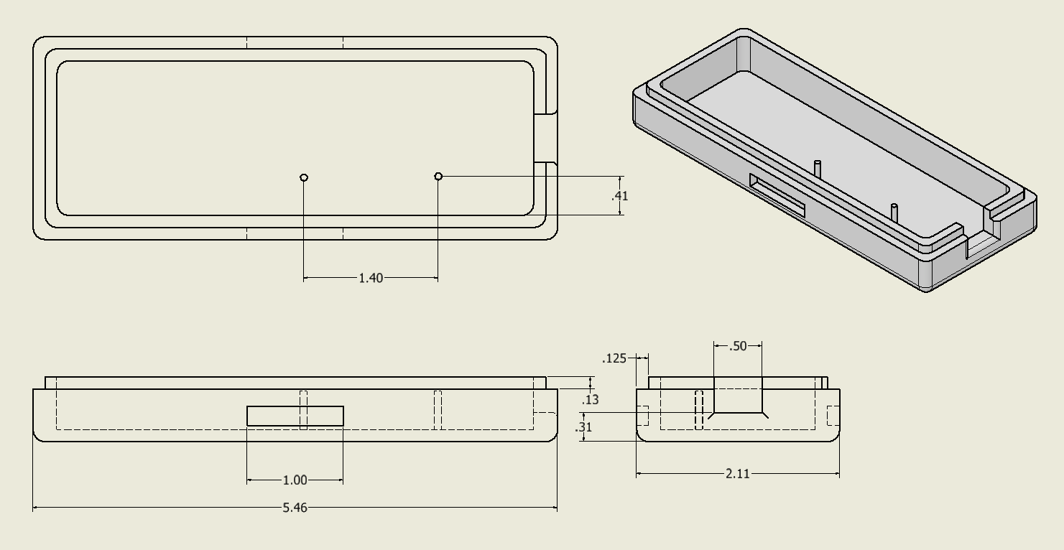
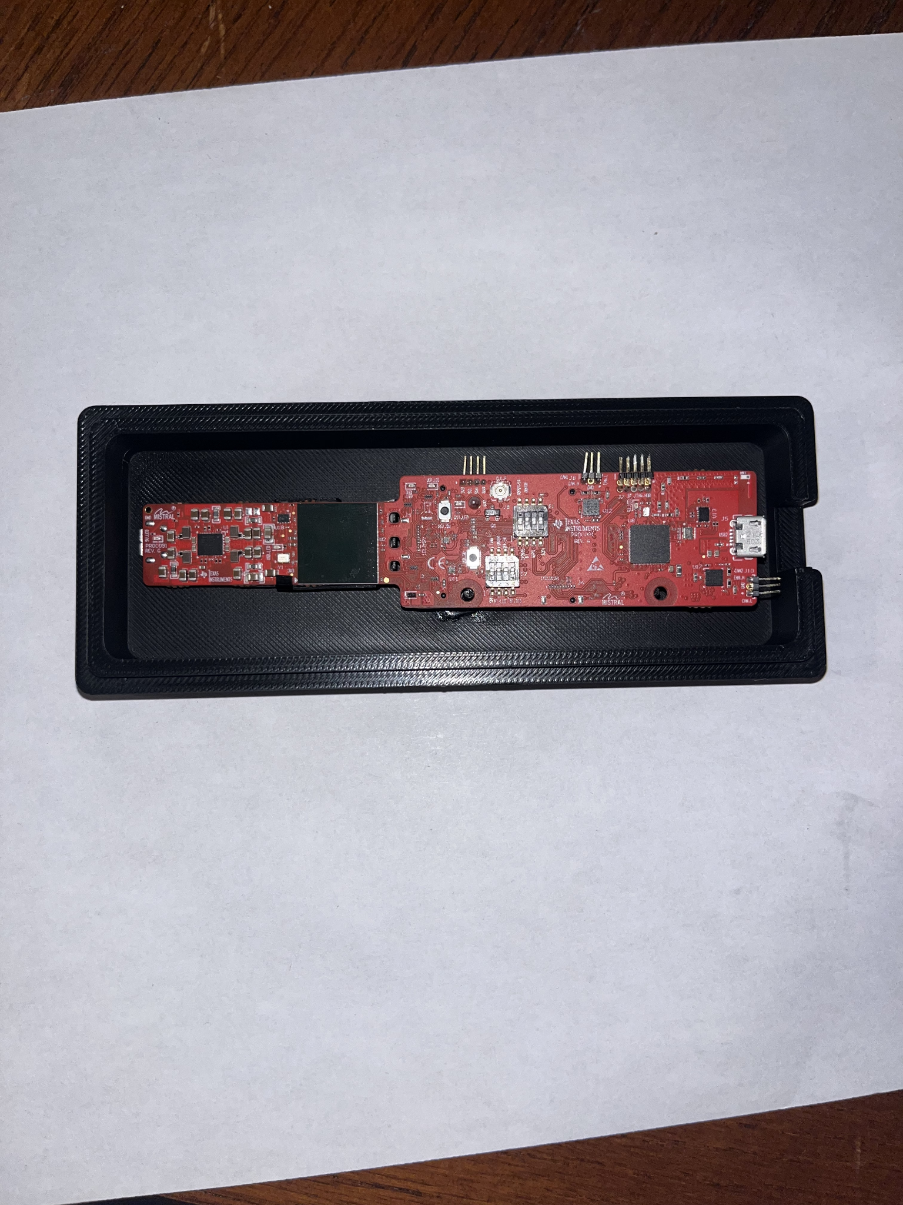
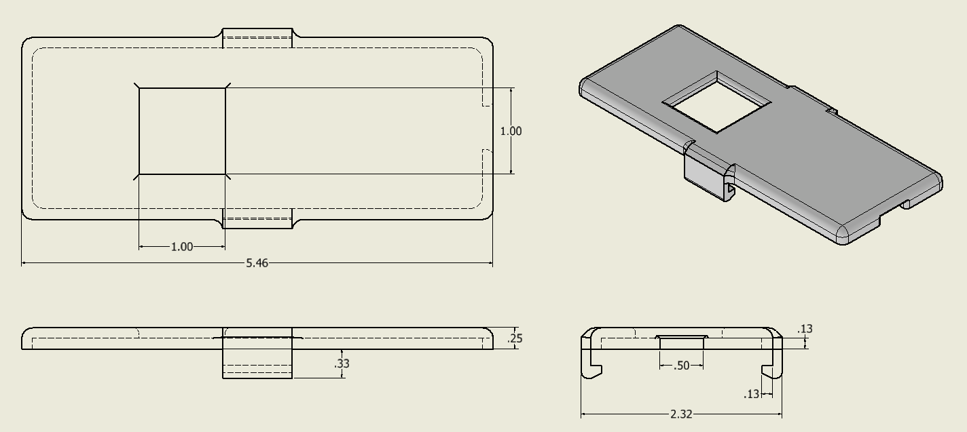
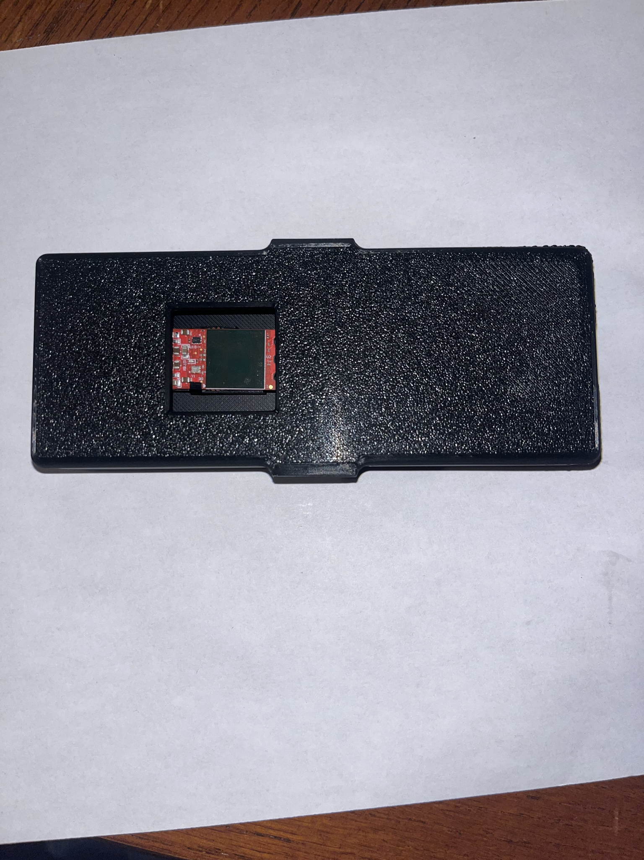
Second Model of Case
Notes:
The second model created was significantly reduced in size; however, it was still a bit bigger than I anticipated, and the device would slouch instead of stand up right. Additionally, the window was a bit too small and I was worried it would interfere with the signals from the sensor.

Slide 13
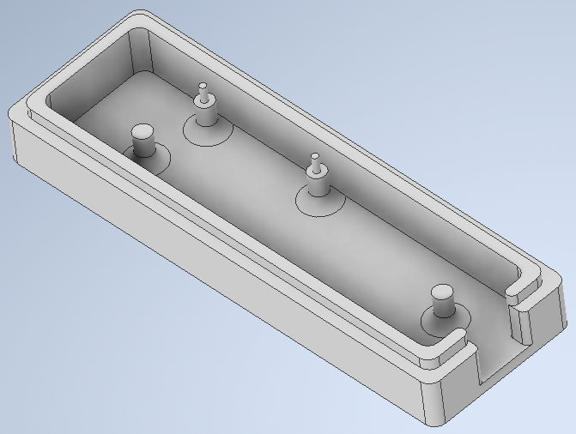
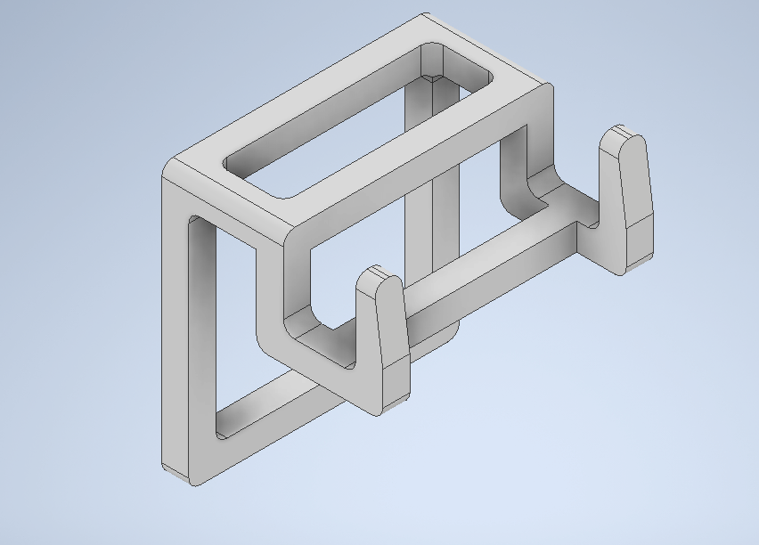
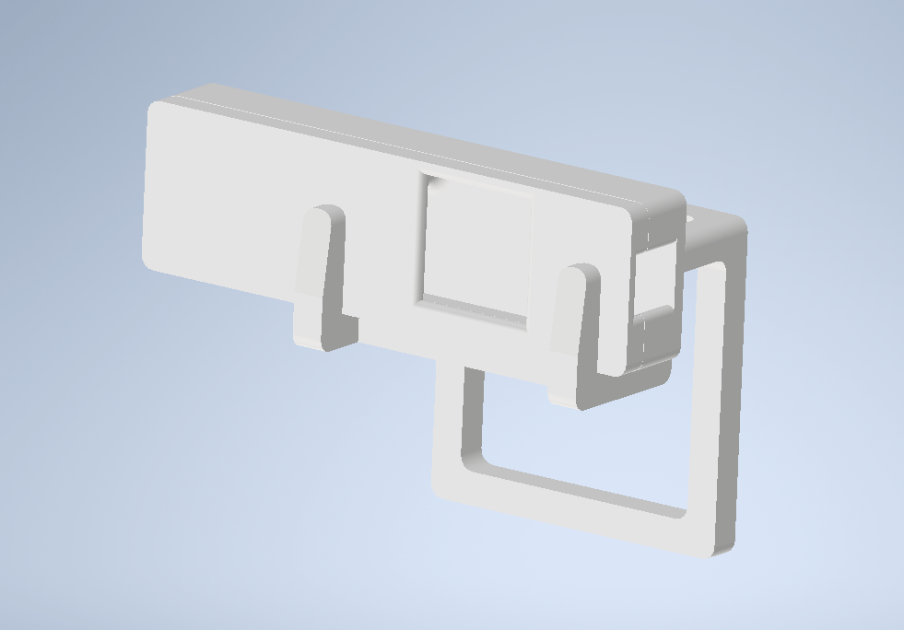
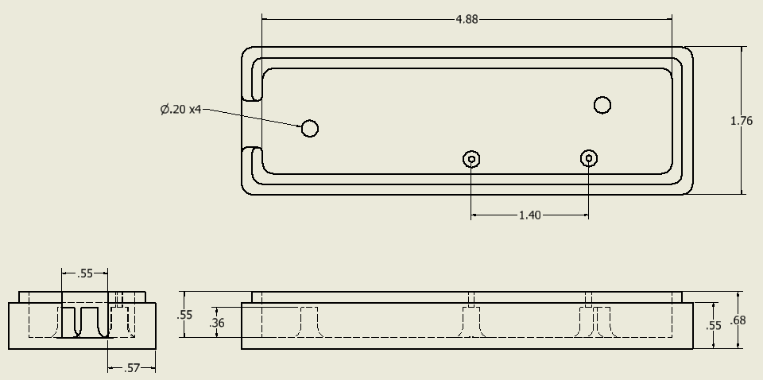
Final Model of Case and Mount
Notes:
And here is the final case prototype, as well as a simple mount for it to sit on top of a screen. I added a few more supports in the bottom of the case, reduced its overall size slightly, and increased the size of the sensor window.

Slide 14
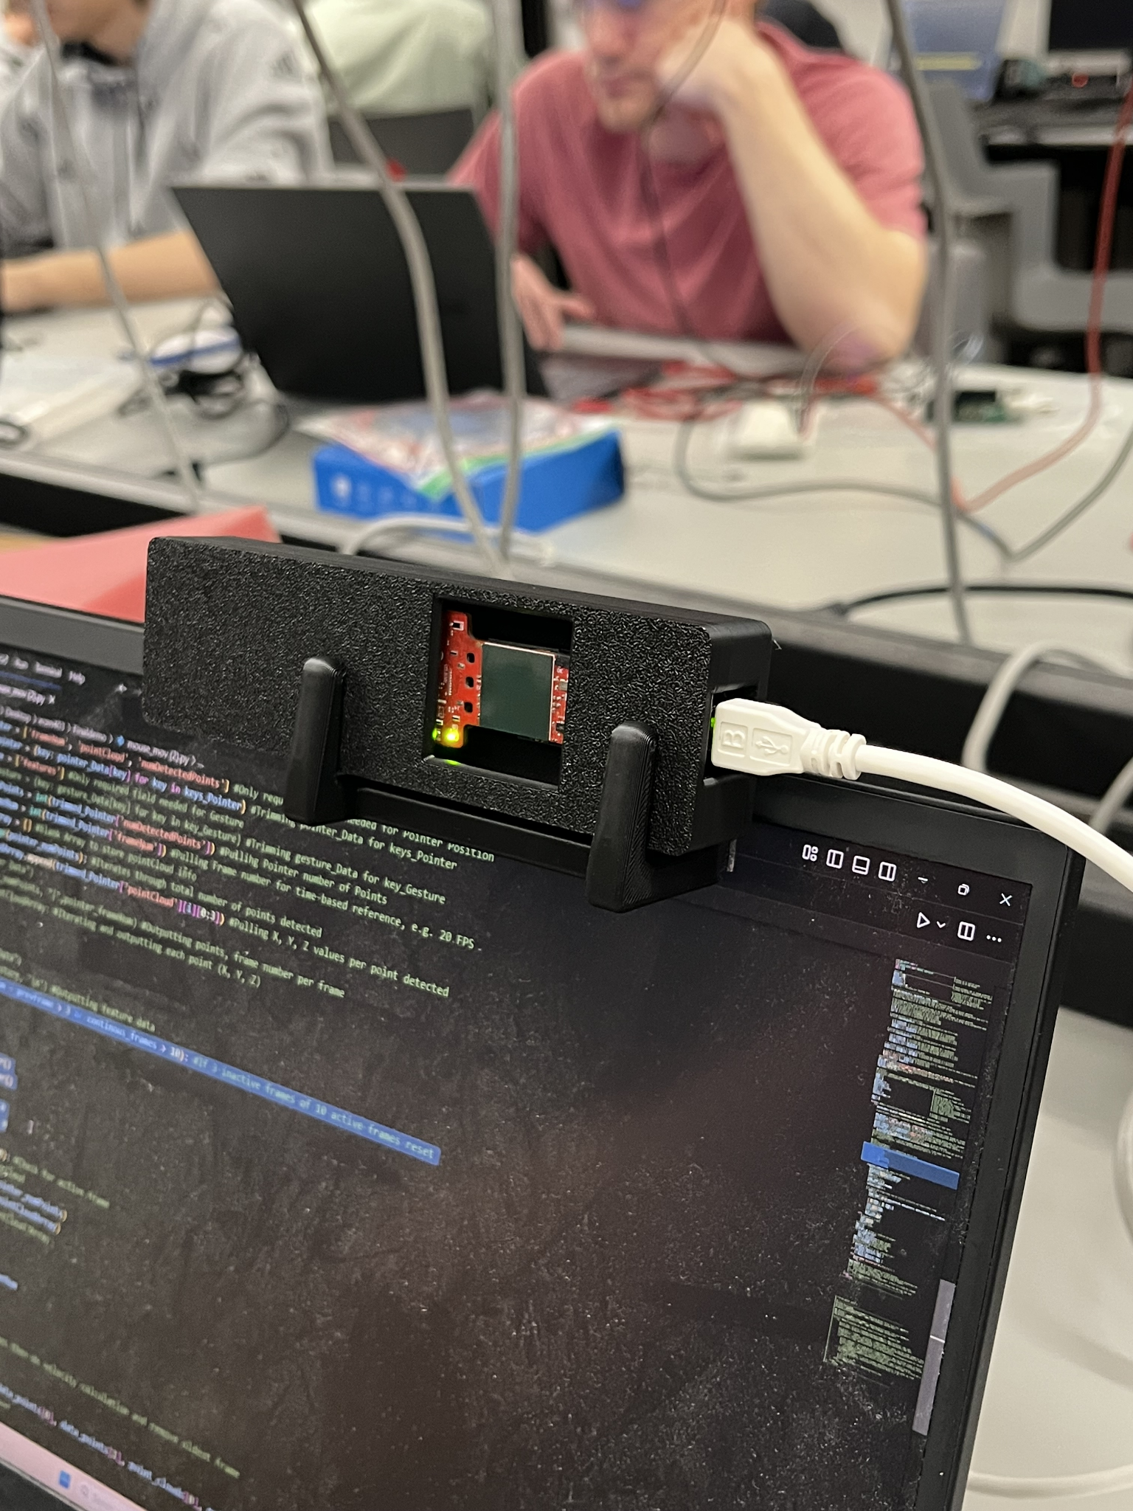
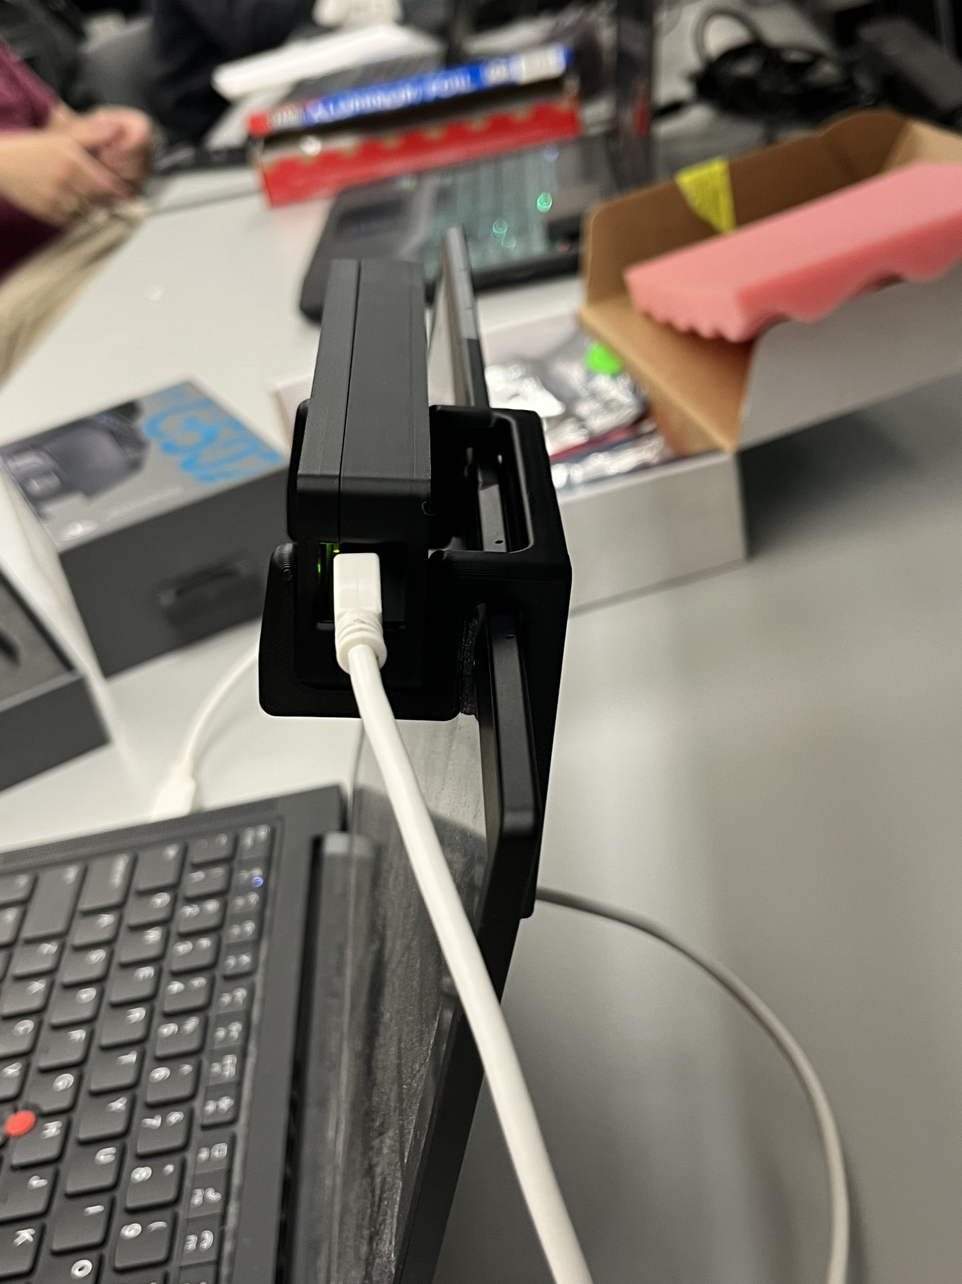
Final Radar Case and Mount
Notes:
And this was the result! It worked surprisingly well and made it far more convenient to use the virtual mouse.

Slide 15
Changes to Gesture Recognition
Gesture Recognition
Oscar Chavez Araiza
To reduce the number of radar modules used, the ML model was retrained using OOB binary data
Features used:
avg_x
avg_y
avg_z
avg_doppler
num_points

Slide 16
The Model
The new model kept the CNN(convolutional neural network) architecture, but changed the number of frames from 45 to 30 and the number of features from 10 to 5
The model works by analyzing the features within 30 frames [30x5], and produces prediction based on that data
Prediction labels:
SHINE – PULL (New) – NO_GESTURE
PUSH – SHAKE (New)

Slide 17
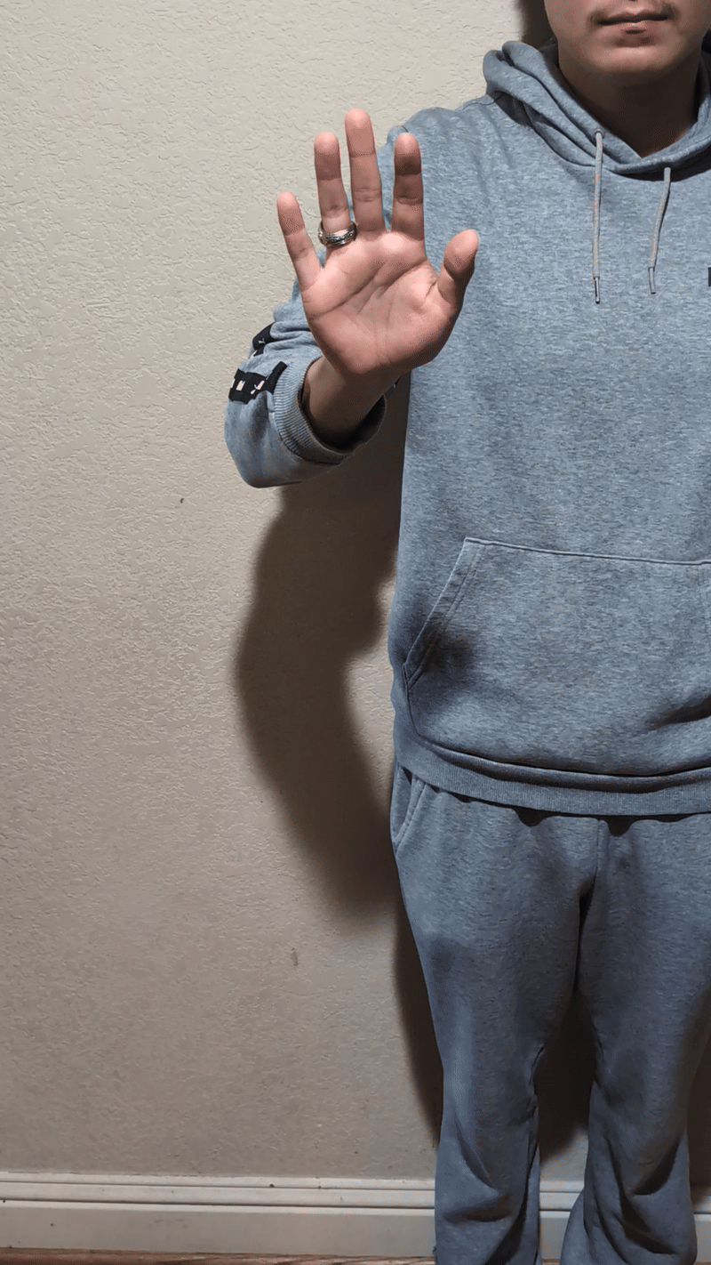
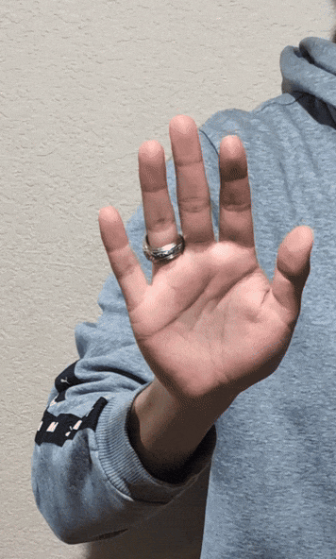
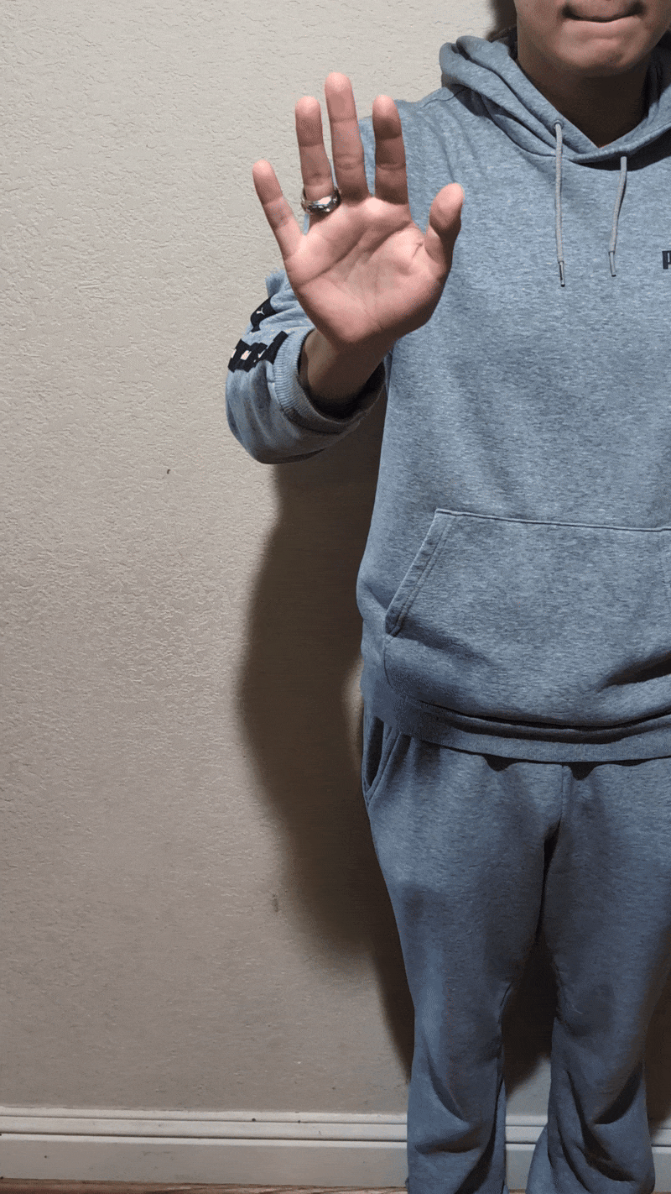
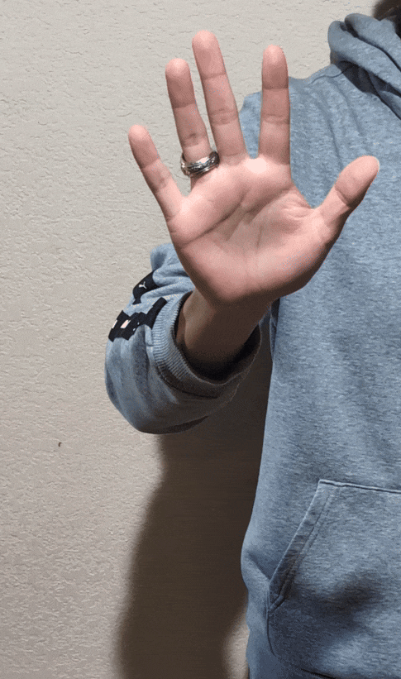
Gestures
Gestures were chosen in a way that it would minimize interference with the tracking algorithm
These gestures mostly use the y direction while tracking utilizes the x and z direction
PUSH PULL SHINE SHAKE

Slide 18
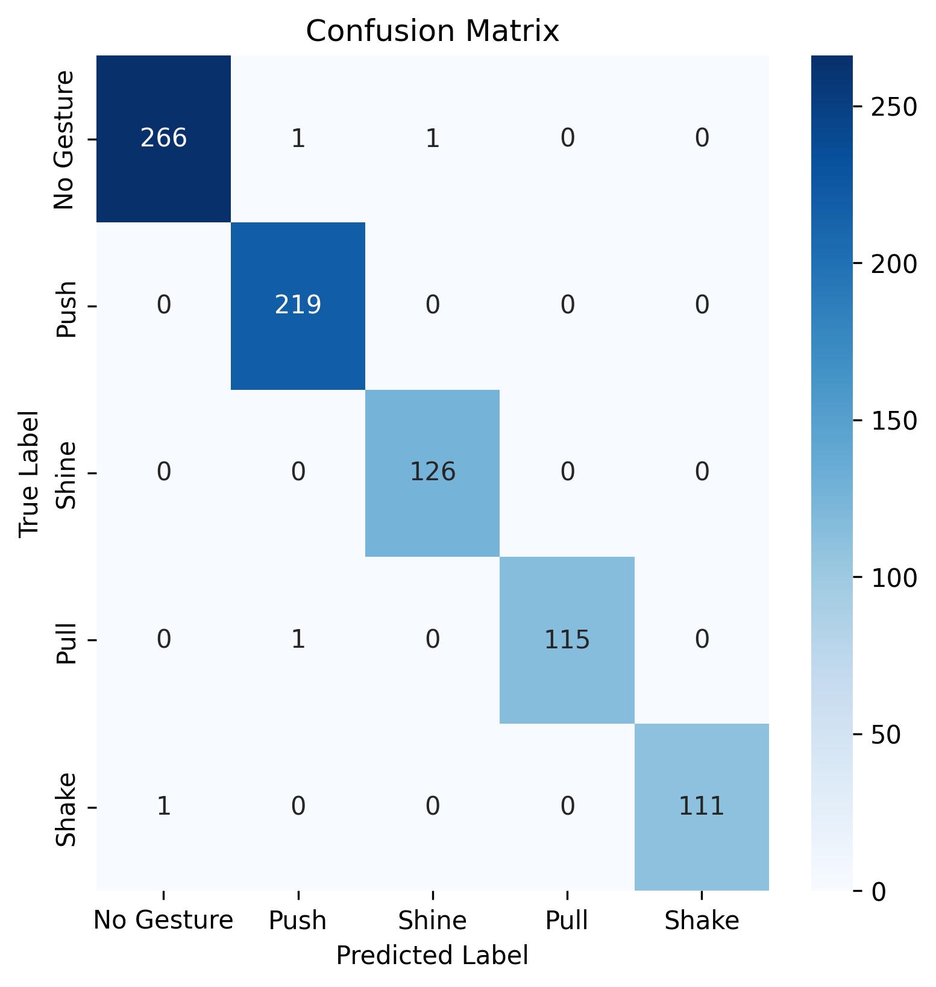
Validation Performance
The model has very few incorrect predictions
During validation the model performed well with an accuracy of ~99%

Slide 19
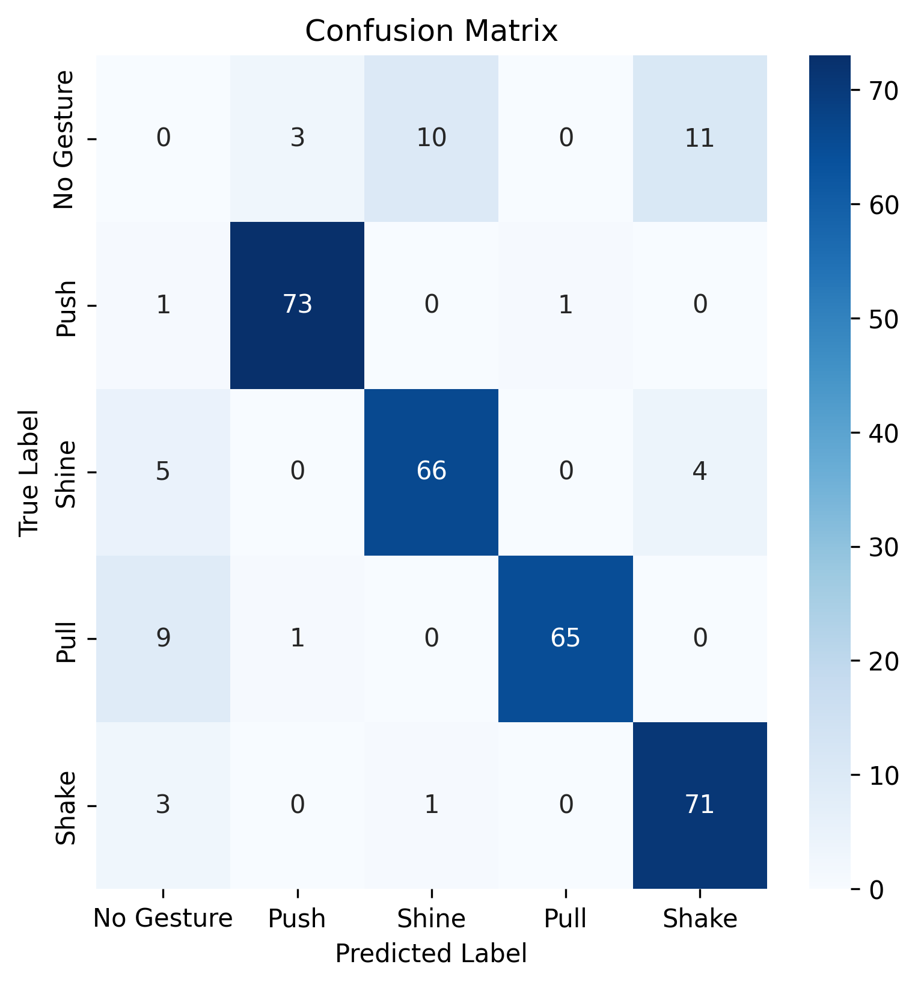
Real Time Performance
Under real time testing the model performed slightly worse than during validation with an accuracy of ~92%
During 30 minutes of moderate use the mouse identified 24 false positives
75 sec between false positives

Slide 20
Engineering Design Challenges
The radar output was noisy and inconsistent
Noise: The effect of the noise was minimized by using the averages of all points in a frame as features
Inconsistent Data: Used the idea of “empty frames” when no meaningful data was captured in a given frame. This empty frame would have all features be 0 instead of skipping the frame
Retrained the model multiple times.
The cfg file was changed many times, so the model was trained multiple times

Slide 21
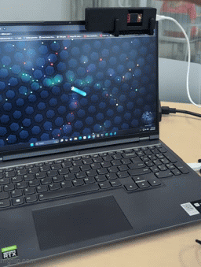
Using the radar to control a game

Slide 22
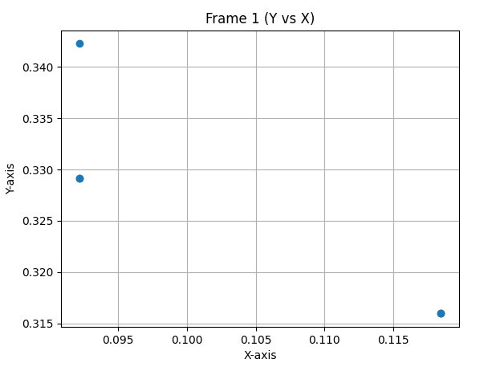
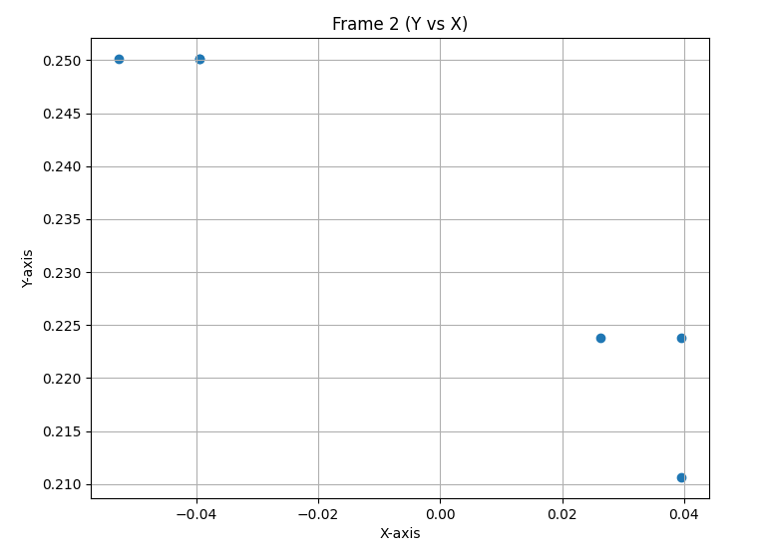
Movement Tracking
Gesture Positioning
Daniel Lu

Slide 23
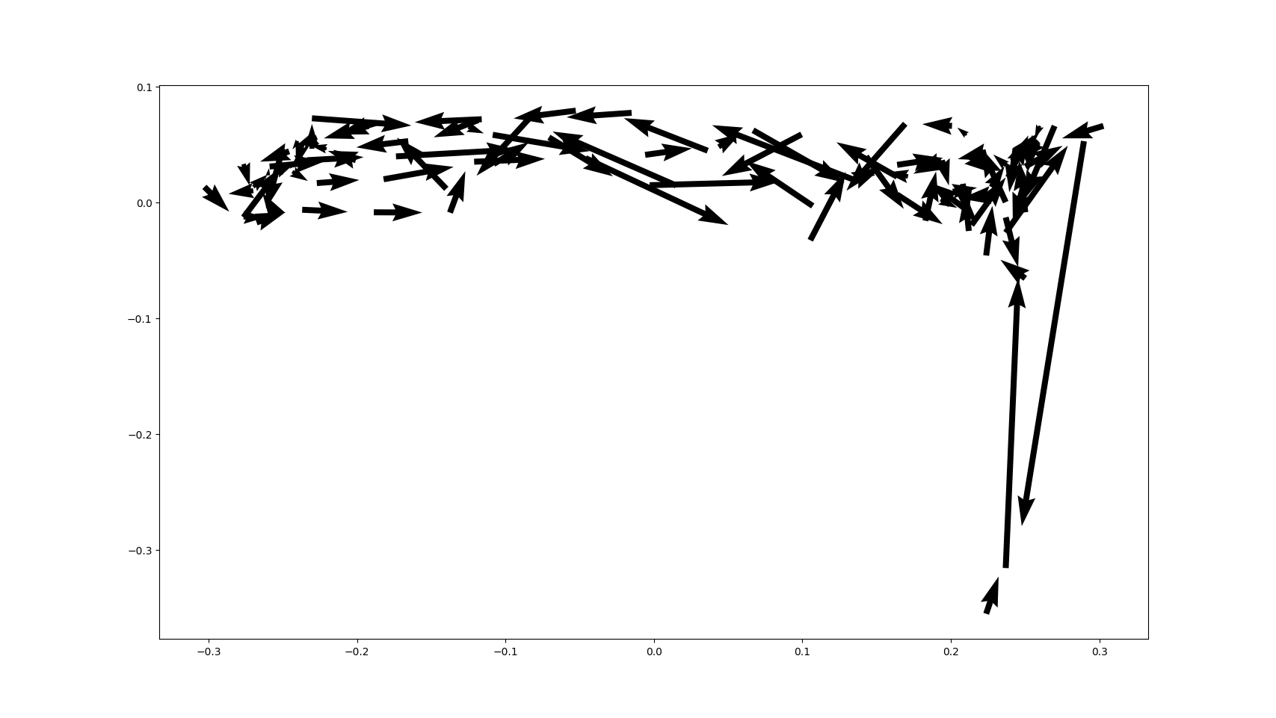
Velocity Vector Plot

Slide 24
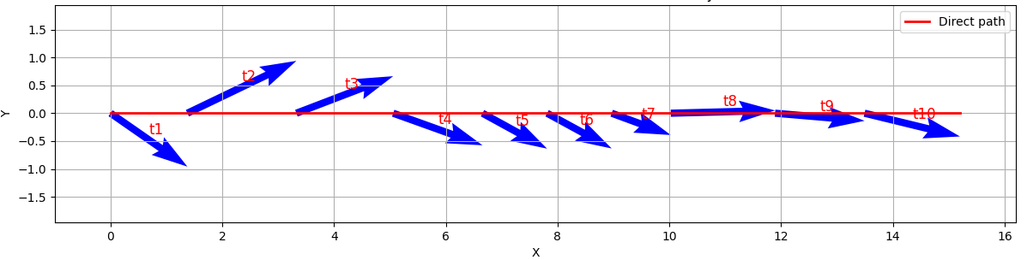
Average weight velocity
Average Velocity = (velocity₁ * weight₁ + velocity₂ * weight₂ + ...) / total weight

Slide 25
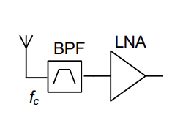
Dominant Velocity
LNA amplified wanted signal
Dominant Velocity takes large portion in movement tracking

Slide 26
difficulty/complexity
The radar output
The moving path of the hand of the user has noise.
The radar output has noise.
The average velocity provides a smooth path but cannot remove the noise coming from the user’s hand.
Ex. The user tried to move ideally in the horizontal direction, but the moving path always contained a y-noise-component in reality.
Solution: dominant velocity and position tracking

Slide 27
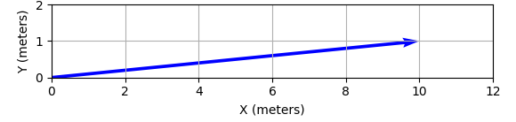
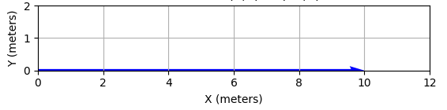
Dominant Velocity

Slide 28
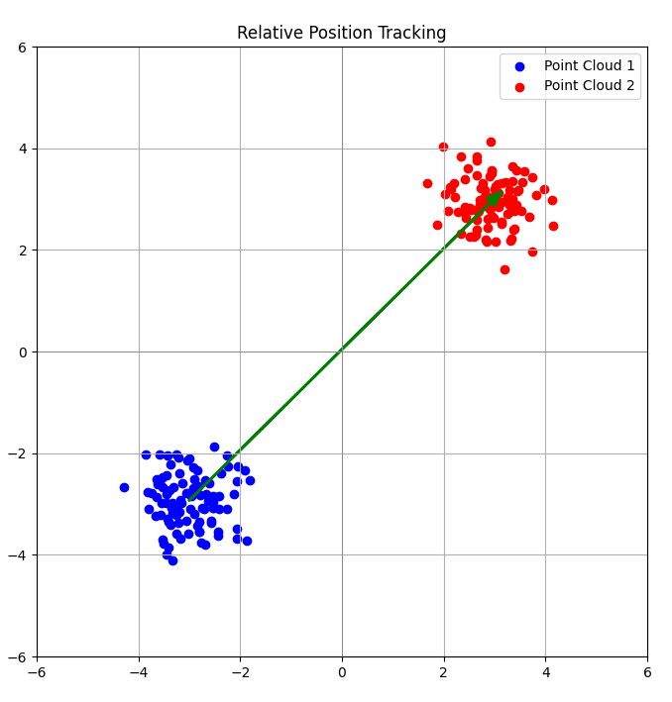
Second Algorithm - Position Tracking
The mouse cursor moves to a position on the screen relative to the position of your hand with respect to the radar
This algorithm is very sensitive to small movements, thus making it less viable for high precision tasks
Radar

Slide 29
Mouse Smoothing
Input Mapping
Zane Meikle
For every movement, interpolate between the beginning and final point
Then move by that increment for as many frames it is interpolated by
Example: Frames generated = 5
Refresh rate= 30Hz
Move(2, 3)
delay(1/30/5)
Move(2, 3)
delay(1/30/5)
Move(2, 3)
delay(1/30/5)
Move(2, 3)
delay(1/30/5)
Move(2, 3)
delay(1/30/5)
Move(10, 15)
delay(1/30)

Slide 30
Issues
When the frames generated are turned too high (above 10) the movements tends to lag dramatically
This is most likely due to python and the hardware not being able to keep up with that speed
There is also a slight delay compared to the normal mouse movement, this is likely due to

Slide 31
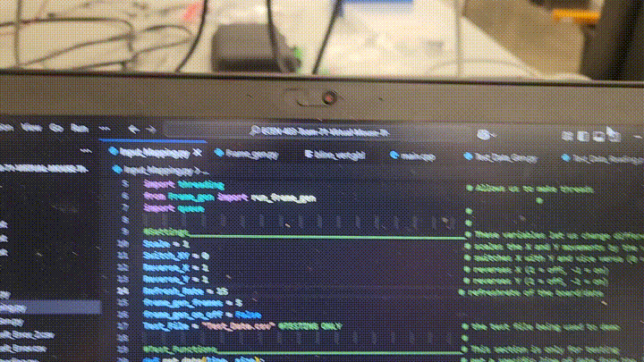
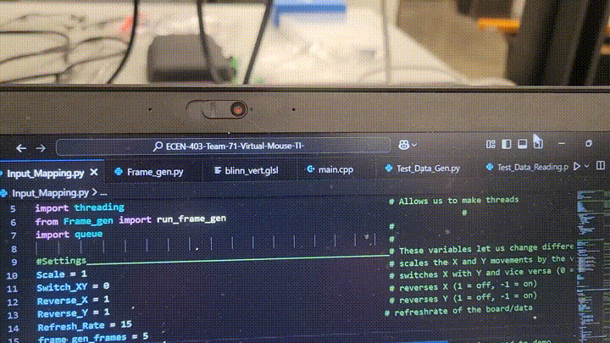
Frame Smoothing OFF vs ON
OFF ON

Slide 32
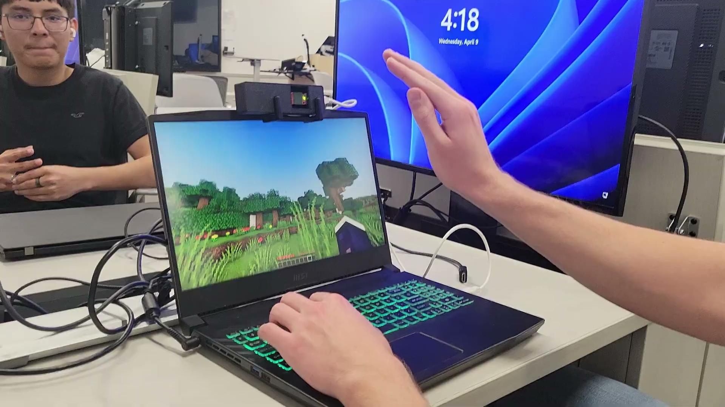
Integrated System Results: Minecraft

Slide 33

Integrated System Results: Minecraft

Slide 34
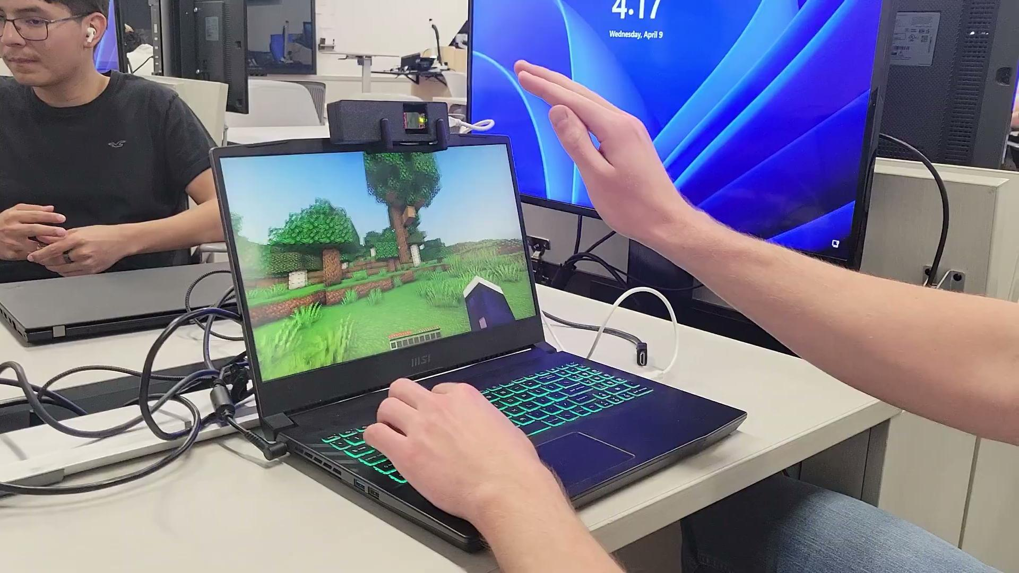
Integrated System Results: Minecraft 2

Slide 35
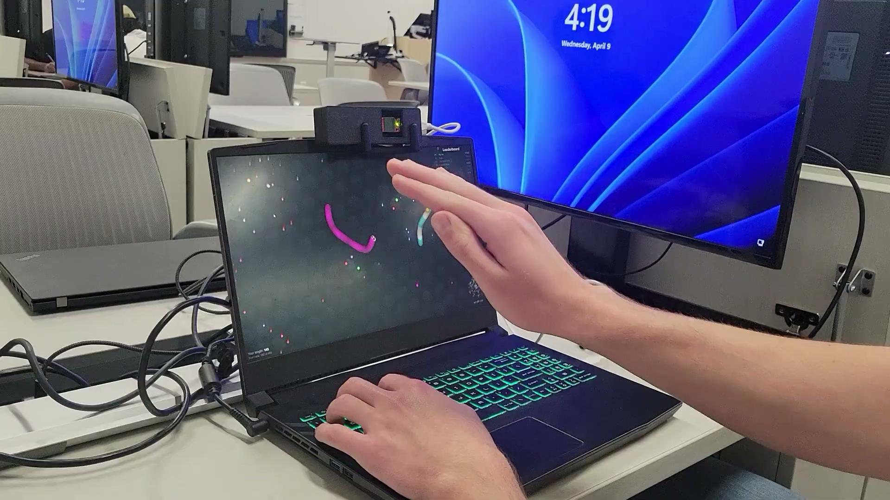
Integrated System Results: Slither.io

Slide 36
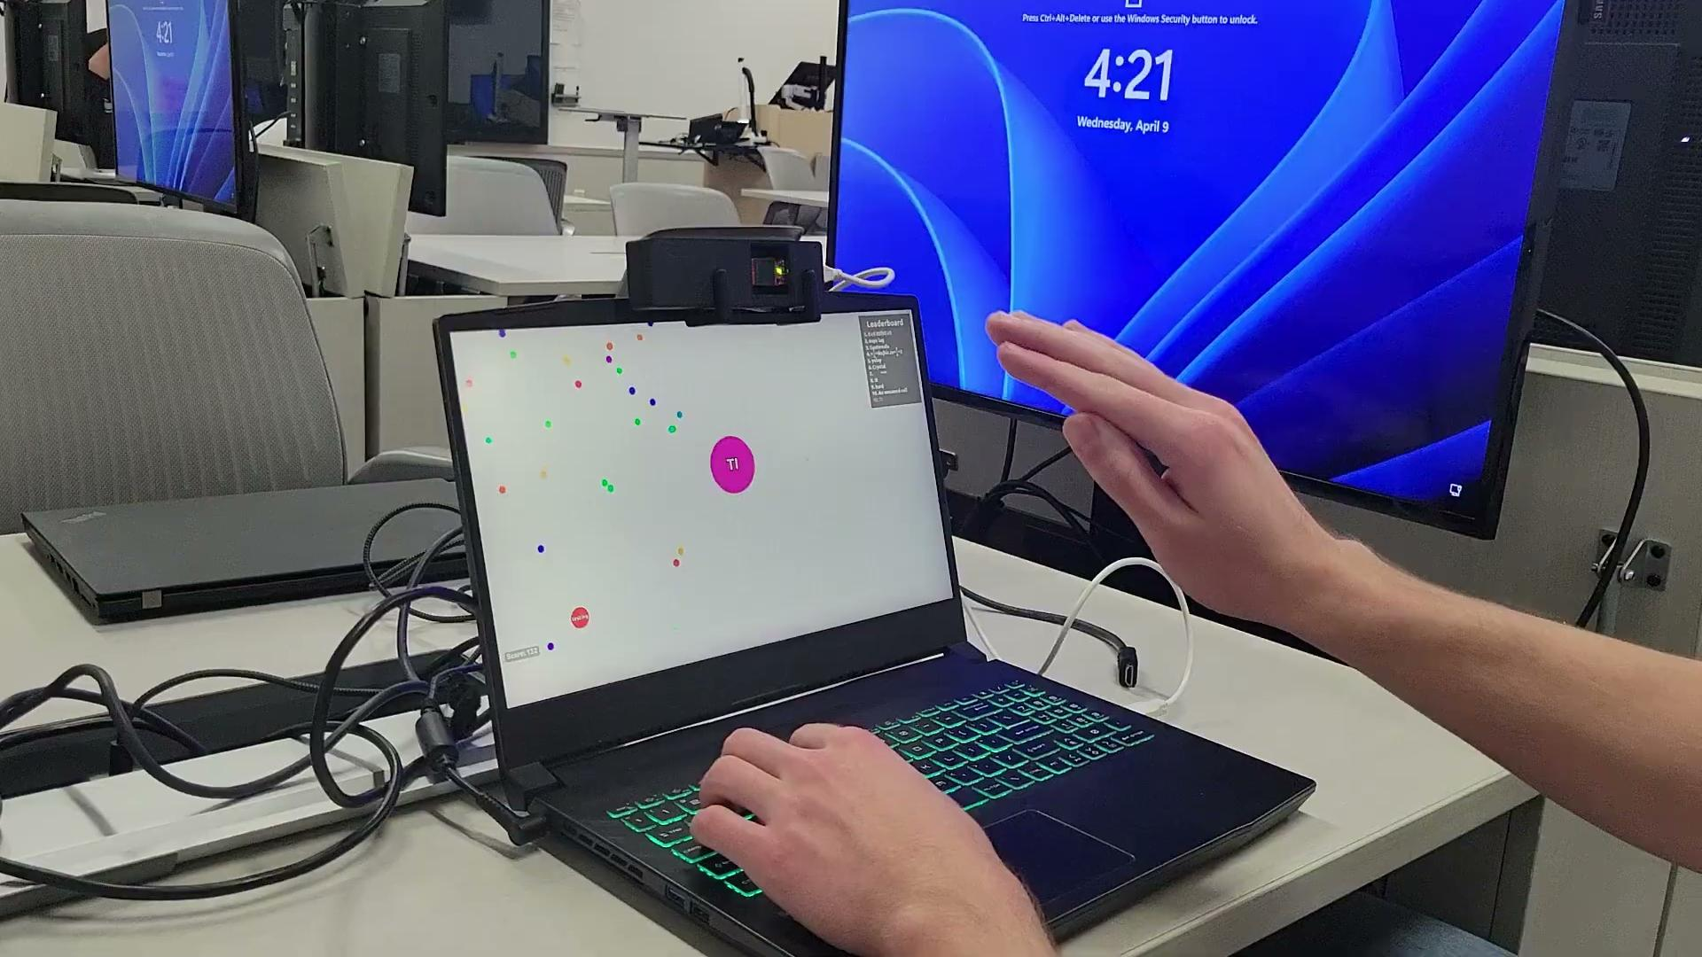
Integrated System Results: Agar.io

Slide 37
Conclusions
Changes to FSR/ICD: we added a GUI, mouse smoothing, position tracking, and more gestures
Current status: we are finished and are working on final documents

Slide 38
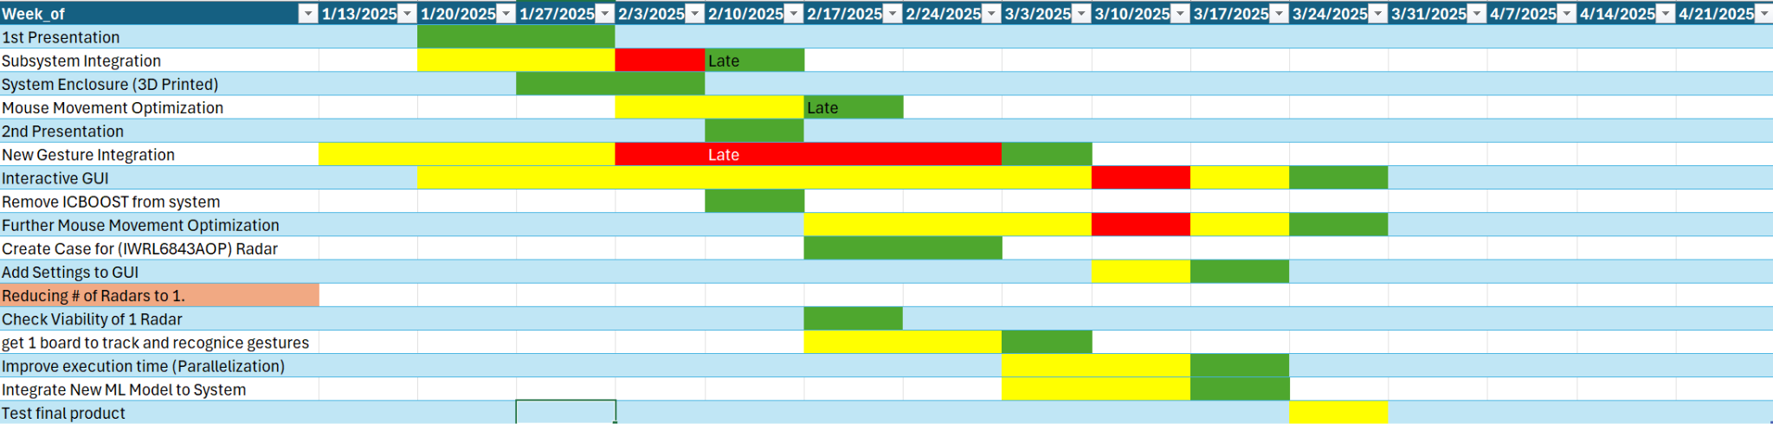
Execution Plan Gantt Chart
#71 - Virtual Mouse using mmWave Radar (TI)

Slide 39
Full System Validation
Task | Specification | Status | Owner
Gesture Recognition | The ML model must correctly identify gestures 95% of the time while integrated. | Failed | Oscar
Tracking | The program must be able to reliably track the hand. | Passed | Daniel
Frame Generation | The program must be able to correctly interpolate position, in order to add smoothing frames. | Passed | Zane
GUI | The user must be able to change all settings successfully using the program GUI | Passed | Grayson

Slide 40
Validation Plan
Section | Task | Specification | Result | Owner
3.2.1.6 | Mouse Movement | Mouse can be moved to all corners of the screen by the program. | Passed | Zane
3.2.1.6 | Mouse Actions | The program must be able to right click and left click. | Passed | Zane
3.2.5.2 | Mouse Input Error Handling | The program must properly handle all invalid inputs. | Passed | Zane
3.2.1.4 3.2.1.6 | Gesture positioning | The coordinates of the gesture should be calculated when deleting the error points. | Passed | Daniel
3.2.1.6 3.2.1.8 3.2.3.2.1 | Velocity accuracy | The output velocity of the moving gesture should not have errors. | Passed | Daniel
3.2.1.5 | Hand Gesture Recognition | ML model can recognize the users hand gestures | Passed | Oscar
#71 - Virtual Mouse using mmWave Radar (TI)

Slide 41
Validation Plan
Section | Task | Specification | Result | Owner
3.2.1.5 | Gesture Recognition Accuracy | ML model can correctly identify and categorize hand gestures at least 90% of the time. | Passed | Oscar
3.2.1.7 | Functional Radar System | The IWR6843AOPEVM properly communicates with the computer and transmits data. | Passed | Greyson
3.2.1.8 | Data Decoding | The python script accurately decodes the TLV data seen from both radars. | Passed | Greyson
3.2.1.3 3.2.1.4 | Radar Angle and Distance | The radars can capture gestures and pointer positions within a 90 degree range up to 1.5 feet | Passed | Greyson
3.2.1.5 | Hand Size | Radar will recognize gestures regardless of hand size. | Passed | Oscar
#71 - Virtual Mouse using mmWave Radar (TI)

Slide 42
Thank you, that is all.

